Slide 1


AUTOMATIC MEDICINE
REMINDER AND DISPENSER
Presented by S.Teja

Slide 2
OUTLINE
Introduction
Literature review
Objective
Work done
Results and
discussion
Specifications/Components
used
Conclusions

Slide 3
INTRODUCTION
Medication reminders are essential for elderly patients, as nearly 50% forget their daily doses, leading to serious health complications. To reduce this risk, the Automatic Medicine Dispenser provides a low-cost and reliable offline solution.
It automates timely medicine alerts without needing internet or smartphones. This ensures safer, more consistent medication habits at home.

Slide 4
Literature review
Early medication reminder systems relied only on alarms and required full user involvement, providing no automation.
Advanced IoT-based dispensers were introduced later, but they are expensive and depend on internet access or smartphone apps, making them unsuitable for many elderly users.
we can see a clear need for a simple, affordable, offline dispensing solution—a gap that this project successfully addresses.

Slide 5
OBJECTIVE
To design an automated system that dispenses medicines at scheduled times
To achieve accurate timing using DS3231 RTC
To ensure precise tray rotation using 28BYJ-48 stepper motor
To store schedules permanently using EEPROM
To create a simple and user-friendly device, especially for elderly users

Slide 6
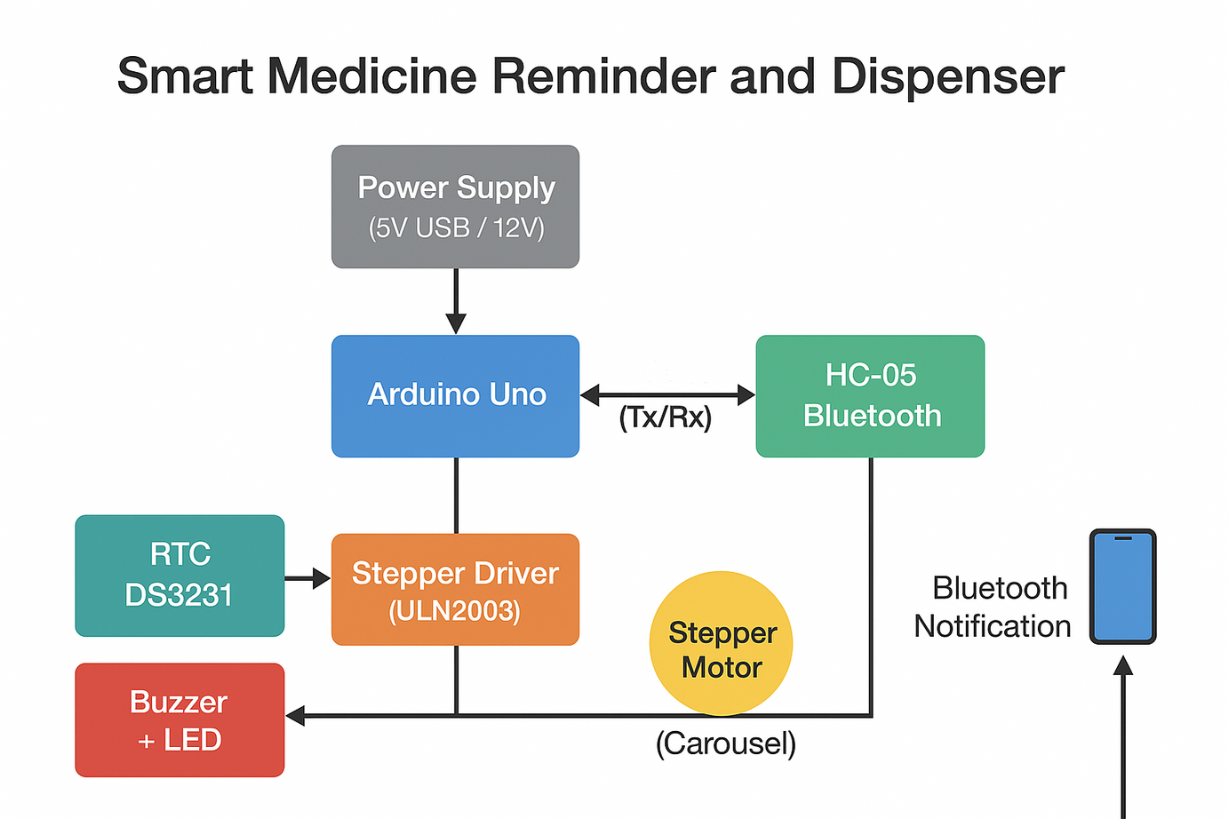
Block Diagram

Slide 7
SPECIFICATIONS / COMPONENTS
 | Components | Specification
1 | Arduino Uno | ATmega328P, 5V logic, 16 MHz clock
2 | DS3231 RTC | ±2 ppm accuracy, 3.3–5V, CR2032 battery backup
3 | 28BYJ-48 Stepper Motor | 5V, 2048 steps/rev (or 4096), 1/64 reduction ratio
4 | ULN2003 Driver Board | 7-channel Darlington array, 5V input
5 | LED Indicators (4 pcs) | 5mm LED, 20 mA current

Slide 8
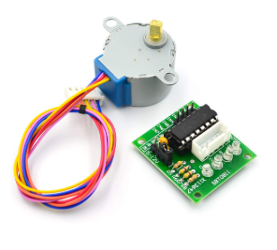
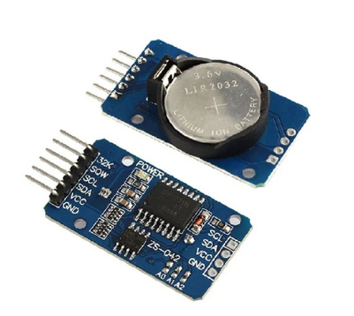
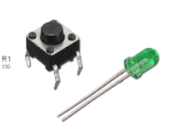
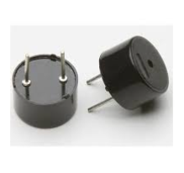
SPECIFICATIONS / COMPONENTS
 | Components | Specification
6 | Buzzer (Passive) | 5V DC, piezoelectric
7 | Resistors | 220Ω (for LEDs)
8 | Power Supply | 5V regulated USB

Slide 9
WORK DONE
1) Mechanical Design :-
Designed a circular tray divided into 4 equal compartments.
Calibrated the stepper motor to rotate 512 steps = 90°, ensuring precise alignment for each slot.
2) Hardware Integration :-
Arduino Uno connected to the DS3231 RTC using the I²C interface (SDA, SCL).
28BYJ-48 Stepper Motor controlled through the ULN2003 driver board for stable rotation.
LED indicators and buzzer wired to digital pins for user alerts.
Power connections arranged to minimize electrical noise affecting motor accuracy.

Slide 10
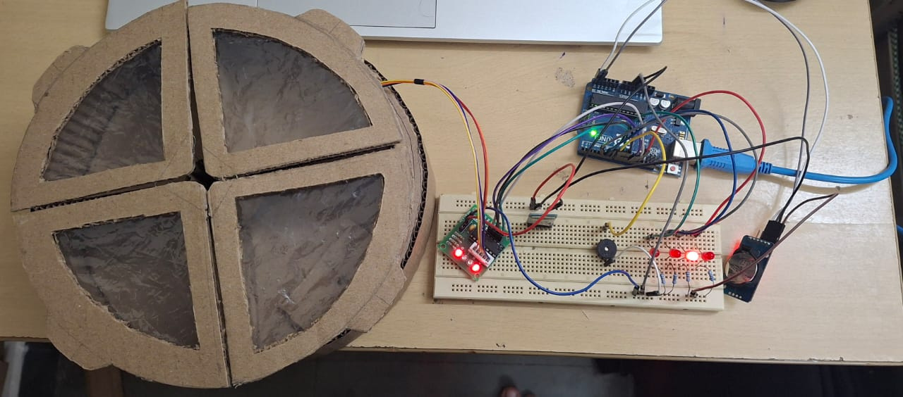
WORK DONE

Slide 11
WORK DONE
3) Software Development:-
Program organized into modular sections for:
Real-time clock reading
Alarm setting and scheduling
EEPROM-based storage of timings
Stepper motor rotation control
LED + buzzer alert routines
4) Testing & Verification :-
Stepper motor tested for repeated 90° rotations
EEPROM validated by power cycling to ensure alarm data is retained.
Overall system tested for smooth operation and reliability

Slide 12
WORK DONE
3) Software Development:-
Program organized into modular sections for:
Real-time clock reading
Alarm setting and scheduling
EEPROM-based storage of timings
Stepper motor rotation control
LED + buzzer alert routines
4) Testing & Verification :-
Stepper motor tested for repeated 90° rotations
EEPROM validated by power cycling to ensure alarm data is retained.
Overall system tested for smooth operation and reliability

Slide 13
RESULTS AND DISCUSSION
The system operated smoothly and consistently during all tests.
The DS3231 RTC provided highly accurate timekeeping with no drift observed.
The stepper motor delivered precise 90° rotations, ensuring correct compartment alignment every time.
LED indicators and the buzzer produced clear and immediate alerts, making the system easy for elderly users to understand.
Overall, the device proved to be reliable, low-cost, and practical for real-world household healthcare applications.

Slide 14
CONCLUSIONS
The Smart Automatic Medicine Dispenser successfully achieved its goal of providing a simple, accurate, and automated method for timely medication delivery.
The system proved to be easy to use, cost-effective, and fully offline, making it suitable for elderly users and households without internet access.
The project demonstrates how embedded systems can offer practical healthcare solutions and can be further expanded with GSM, IoT, or additional compartments in the future.

Slide 15
Thank You

